Slide 1
Office Solutions Development
Topic 4:
Advanced Features and Functions of Microsoft Access, Excel and Word
Notes:
NCC Education - Title Master

Slide 2
Scope and Coverage
This topic will cover:
  Some of the advanced features and functions of Microsoft Access, Excel and Word.
Notes:
NCC Education - Slide Master

Slide 3
Learning Outcomes
By the end of this topic, students will be able to:
  Have knowledge of some of the advanced features and functions in Access (we will use some of these with macro development in Topic 7)
  Develop some of the advanced features and functions in Excel
  Develop some of the advanced features and functions in Word

Slide 4
Terminology
  Terminology will be explained in the lecture, tutorial and laboratory session. You should take notes!
  Ask questions if you do not understand.

Slide 5
Uses of Advanced Features and Functions
  These are used for many purposes, such as:
    keeping records of customer names, staff details, etc.
    budgeting and forecasting
    analysing business data
    developing invoices and other forms
    producing graphs from data

Slide 6
Access, Excel and Word
  These three applications are being referred to because they contain dynamic and efficient advanced features and functions such as:
    data entry, reports, queries (Access)
    conditional formatting, LOOKUP function Pivot Tables (Excel)
    templates and mail merge (Word)

Slide 7
Access: Data Entry
  A user can develop forms that can be used for data input.
  These forms can contain control properties to ensure that the data that is being input accurately, such as having to select from a set number of options, e.g. a list box.
  Forms can include macro instructions and we will discuss this further in Topic 7.

Slide 8
Access: Reports
  A user can customise a report and include features such as conditional formatting, e.g. to highlight the names of customers who still owe payment or products that are no longer for sale.

Slide 9
Access: Queries
  Include:
    parameter queries (prompts a user for criteria when the query is run, so specific data can be extracted)
    parameter queries with multiple criteria (prompts a user for each criteria)
    summary queries (do not show individual records only summaries of averages, totals and any other calculations)
    using functions in queries (where calculations are applied, e.g. displaying pass or fail grades according to if a mark is < or > 50)

Slide 10
Excel: Conditional Formatting
  Conditional formatting is used in Excel to enable the user to create rules that change the formatting in a cell based on the values in the cell.
  It is useful for highlighting parts of the spreadsheet when certain conditions are met, e.g. exam grade recording, sales figures records.

Slide 11
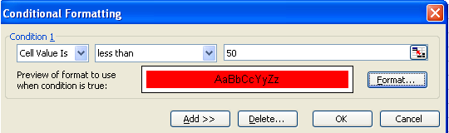
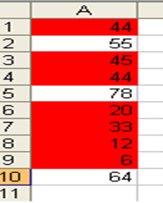
Example of Conditional Formatting
Conditional formatting has been applied to highlight grades less than 50.

Slide 12
Excel: LOOKUP Function
  You may need to find a product or product part by its product code or extract data from a large list for a mail merge or to complete an invoice.
  This can take time unless you use the LOOKUP function. It can help you find specific information in large lists of data quickly and efficiently.
  There are two types of LOOKUP function:
    VLOOKUP and HLOOKUP

Slide 13
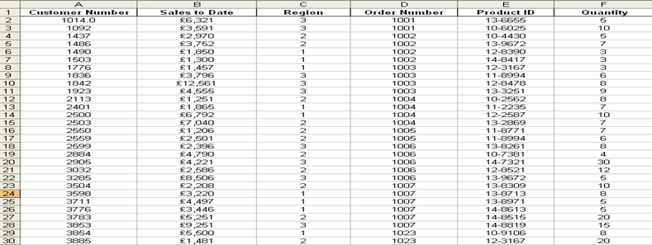
VLOOKUP
  A VLOOKUP is so-called because it looks up (searches for) the data based on a cell reference in a Vertical list:

Slide 14
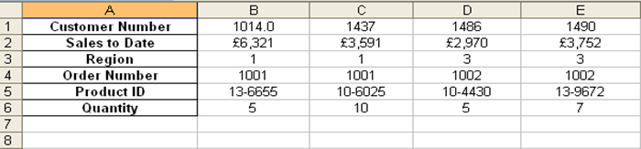
HLOOKUP
  An HLOOKUP is so-called because it looks up (searches for) the data based on a cell reference in a Horizontal list.
  It can be used if data is set out horizontally in rows, rather than in columns.

Slide 15
Excel: Pivot Tables
  These enable users to analyse large amounts of data, which can be sorted, counted and totalled.
  Reports can be produced from the table that summarise the data.
  Data can be imported or linked to other sheets and workbooks.
  Graphs can also be generated from the data found.

Slide 16
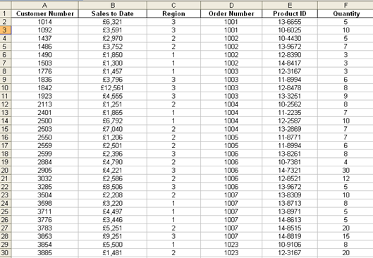
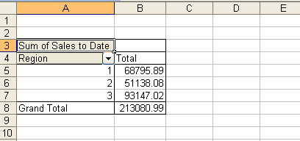
Pivot Table Example
Sum of sales to date in each region

Slide 17
Word: Templates
  This is useful for documents that will be used many times, such as a document containing a letterhead.
  This helps save time and effort and improve productivity.
  Templates can also apply to reports, memos, brochures, etc.
  They are also used in Excel (invoices, order forms, etc.) and Access (reports, order forms, etc.).

Slide 18

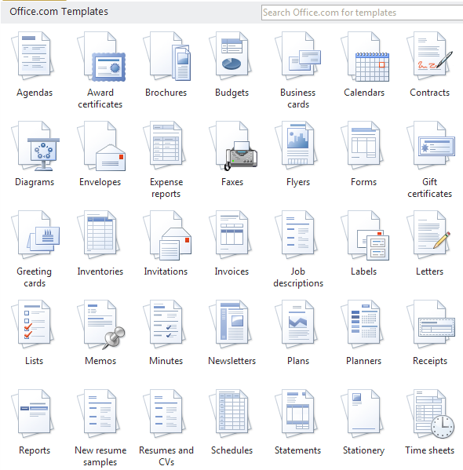
Word Templates

Slide 19
Word: Mail Merge
  Enables a user to produce duplicate copies of a document with each copy being customised in a certain way, e.g. the recipient name and address will be different on each one.
  This saves considerable time and effort in producing business documents, such as letters, labels and envelopes.

Slide 20
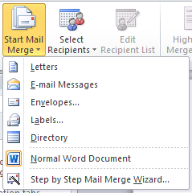
Mail Merge Sample Documents

Slide 21
Mail Merge Stages of Development - 1
  There are a number of stages involved in a mail merge:
    Decide what type of merge is required (letter, labels, etc.)
    Produce the document that will be used for the merge.
    Create/open the data source that will be used to provide the personal details for each copy, e.g. names and addresses.

Slide 22
Mail Merge Stages of Development - 2
    Insert data fields into the document where the personal details and other details (such as the current date) can be added.
    Perform the merge to create the copies of the document.

Slide 23
References
  Microsoft Office online help (2011) http://office.microsoft.com

Slide 24
Topic 4 – Advanced Features and Functions of Microsoft Access, Excel and Word
Any Questions?
Notes:
NCC Education - End Slide Master

